Slide 1

Business Analytics
ZILLOW'S ZESTIMATE: REVOLUTIONIZING REAL ESTATE WITH MACHINE LEARNING AND DATA ANALYTICS
GROUP-5

Slide 2
TEAM MEMBERS
RITIKA AKODE
RUTHVICK BULAGAKULA
GANESH KAMASANI
BHARADWAJ YEDHAGIRI

Slide 3
INTRODUCTION
Zillow's Zestimate home valuation has shaken up the U.S. real estate industry since first released 11 years ago. A home is often the largest and most expensive purchase a person makes in his or her lifetime. Ensuring homeowners have a trusted way to monitor this asset is incredibly important. The Zestimate was created to give consumers as much information as possible about homes and the housing market, marking the first-time consumers had access to this type of home value information at no cost. "Zestimates" are estimated home values based on 7.5 million statistical and machine learning models that analyze hundreds of data points on each property. And, by continually improving the median margin of error (from 14% at the onset to 5% today), Zillow has since become established as one of the largest, most trusted marketplaces for real estate information in the U.S. and a leading example of impactful machine learning. This project is the very simplified version of Zillow Prize competition. Zillow Prize was a competition with a one-million-dollar grand prize with the objective to help push the accuracy of the Zestimate even further. Winning algorithms stand to impact the home values of 110M homes across the U.S.

Slide 4
PROJECT OVERVIEW
The significance of our project lies in its potential to revolutionize the real estate industry. By developing an innovative machine learning algorithm, we aim not only to reduce the margin of error in estimating home values but also to offer homeowners a more trustworthy assessment of their most significant assets. This endeavor isn't just about refining a model; it's about positively impacting the lives of 110 million residents across the United States, providing them with the confidence and assurance they need in their real estate transactions.

Slide 5
TEAM CONTRIBUTION
We'd like to acknowledge the contributions of our team members. Ruthvick focused on data preprocessing and cleaning, feature selection, and the implementation of linear regression. Ganesh led exploratory data analysis, visualization of key features, and interpretation of modeling results. Ritika implemented tree-based models, evaluated alternative algorithms, and compared linear and tree models. Bharadwaj took charge of model evaluation, performance metrics, hyperparameter tuning, and documentation.

Slide 6
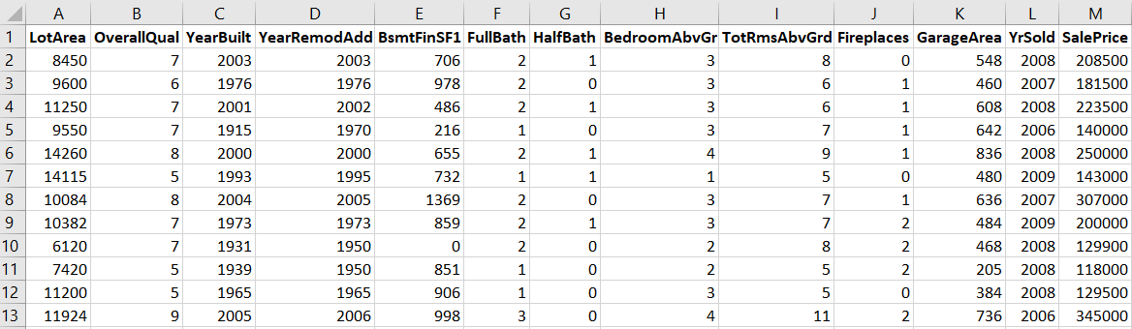
DATA OVERVIEW
Zillow dataset comprises various features related to residential properties, including land size, quality, construction and remodel years, bathroom count, bedrooms, rooms above ground, fireplaces, garage size, and sale price

Slide 7
DATA EXPLORATION
Our analysis uncovered a wealth of insights within the house price dataset. From diverse land sizes, varying quality levels, and a mix of old and new properties to a wide range of construction and remodel years, our findings paint a nuanced picture of the real estate landscape. The variability extends to finished basement space, bathroom counts, bedrooms, rooms above ground, and garage sizes, showcasing the multifaceted nature of residential properties. Notably, our exploration revealed varied fireplace features and a well-distributed range of sales years from 2006 to 2010, providing a comprehensive snapshot of the dataset. Each of these nuances contributes to the uniqueness and value of every property, emphasizing the complexity our model must navigate for a more accurate home valuation system.

Slide 8
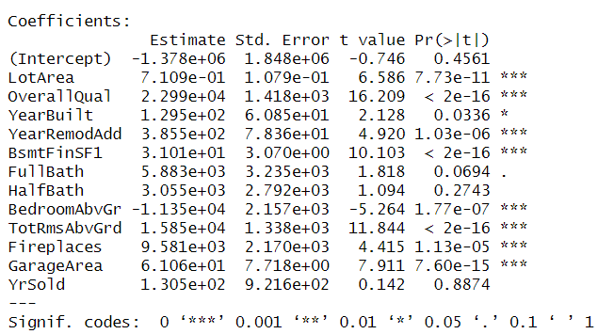
FEATURE SELECTION
For our linear regression model predicting sale price, we selected features with statistically significant relationships. These include land size, overall quality, construction and remodel years, finished basement space, bedrooms, rooms above ground, fireplaces, and garage size.

Slide 9
Model Performance
Linear Model:
Our linear regression model achieved an overall accuracy of 90.56%, with high sensitivity and precision for positive cases. However, its specificity is relatively low, indicating potential challenges in correctly identifying negative cases.
Tree Model:
Our tree-based model exhibited low accuracy and sensitivity, with undefined precision due to no true positives. Although specificity is high, the overall poor performance suggests the model may not be suitable for our task.

Slide 10
FINDINGS AND CONCLUSION
In conclusion, our predictive modeling demonstrated the promising accuracy of our linear regression model in forecasting sale prices, reflecting its robust performance. However, the tree-based model exhibited a need for refinement, indicating potential challenges in capturing the intricate patterns within the dataset. These findings highlight the critical importance of model selection tailored to specific tasks in machine learning. As we continue refining our approach, this insight guides our strategy, emphasizing the need for a nuanced understanding of algorithmic strengths and weaknesses to optimize predictive capabilities. Moving forward, this iterative process positions us to not only enhance the accuracy of Zillow's Zestimate but also contribute to the broader discourse on model selection in the realm of machine learning applications.

Slide 11
FUTURE DIRECTIONS
Moving forward, we plan to explore additional model enhancements, consider alternative algorithms, and refine our approach to further improve the accuracy of Zillow's Zestimate home valuation system.

Slide 12
THANK YOU!

